Slide 1
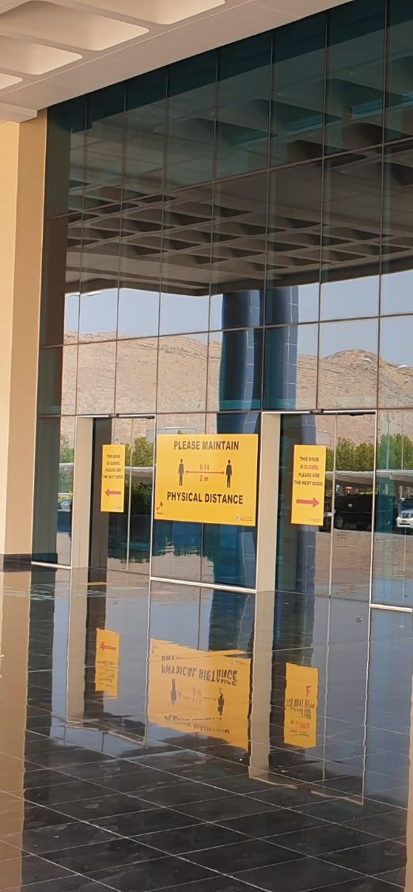


MAF Gradual Return to the Office
Shift Patterns and Desk Arrangements
October 2021

Slide 2

Return to the Office Roster
The gradual return to work programme for MAF has been adjusted, and is now based on a limited number of employees returning of no more than 50%.
This return, with limited capacity numbers is the next step in the overall programme of return to normality. One of the cornerstones the return to the workplace will be the physical segregation of 1.5m for each employee.
This is managed by desks spaced appropriately, coloured with a green or yellow marker on the bottom right corner, in conjunction with a weekly roster aligned to the desk colours.

Slide 3
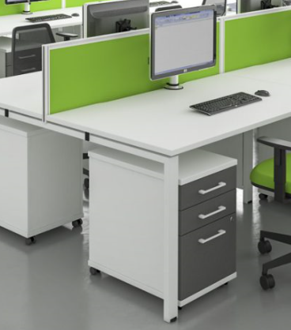



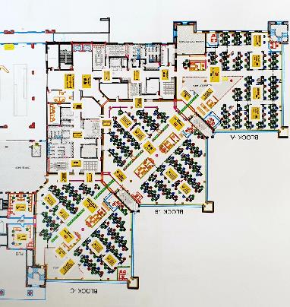
Desk Allocation
Each desk has been labelled with a Green or Yellow sticker placed on the bottom right corner. The colours denote the week in which that employee is shifted to work and is in accordance with a desk layout conforming with the 1.5 metre social distancing requirement.
1.5 Metres

Slide 4
MAF Return to the Office - Weekly Shift Pattern
The weekly roster has been prepared to ensure that each member of staff, when allocated to their desk position knows what week to come in to work and where to sit. This may be in their original desk position or a re-allocated desk space depending on departmental requirement. The implementation of this weekly roster started on 12th July 2020, wit hthis revision being effective w/c 17th October 2021.
In order to ensure numbers do not exceed 50%, team leaders will use their judgement and discretion to ensure that no more than the appropriate number of staff return to the office during this initial period. Over time, these numbers may increase gradually, and as a result staff will be advised when they should return via their team leader.

Slide 5

Communication
To ensure those staff who have been identified to return to work are regularly reminded, a weekly communication will be issued, notifying you of the requirement to return. This reminder will be in conjunction with communication by your team leader, again to ensure that the prescribed number of staff return to the workplace.
Banners will be placed at the entrance of all major buildings as a secondary reminder to ensure that staff are aware of that particular week’s roster colour and do not sit in an incorrect desk position for their designated week.
In addition, meeting rooms have been equipped with facilities allowing a combination of face-to-face meetings in the office with virtual participants. Staff are expected to use these facilities for their meetings in the office.
For the avoidance of doubt, wearing a mask when not sitting at your desk will continue to be expected, as well as compliance with other Transition Controls.
GREEN

